Slide 1
PADDY SEGMENTATION
TRẦN HOÀNG NAM
BÙI TIẾN TÙNG

Slide 2
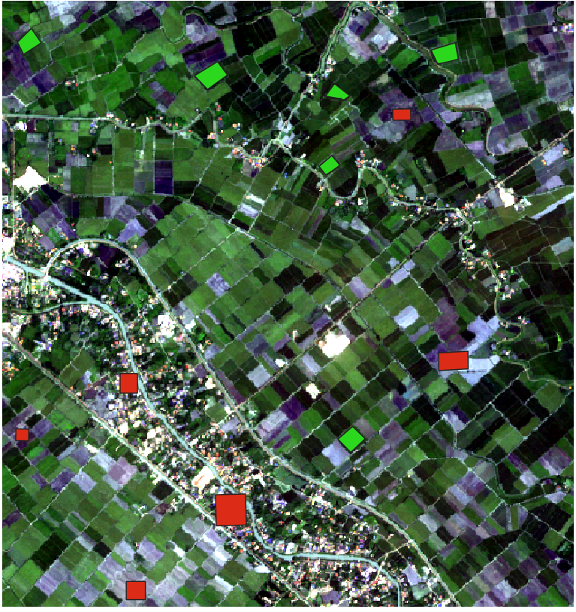

Slide 3
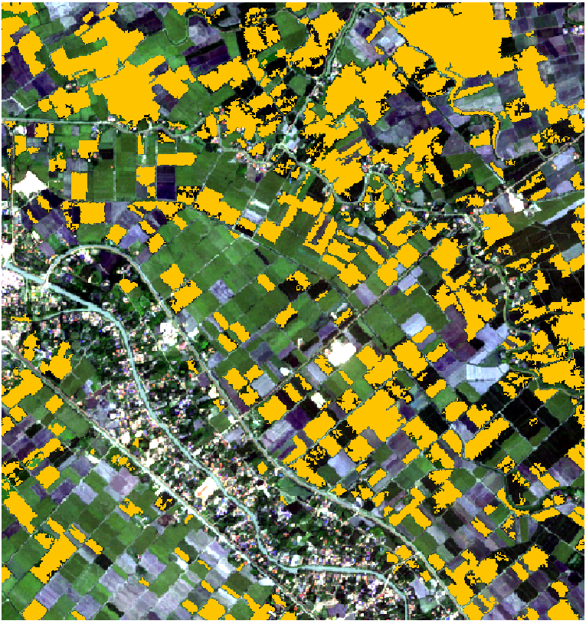
https://colab.research.google.com/drive/1-EDNtzZqzJfBZZTX3Bz3zedRmNlNi-8I

